Slide 1
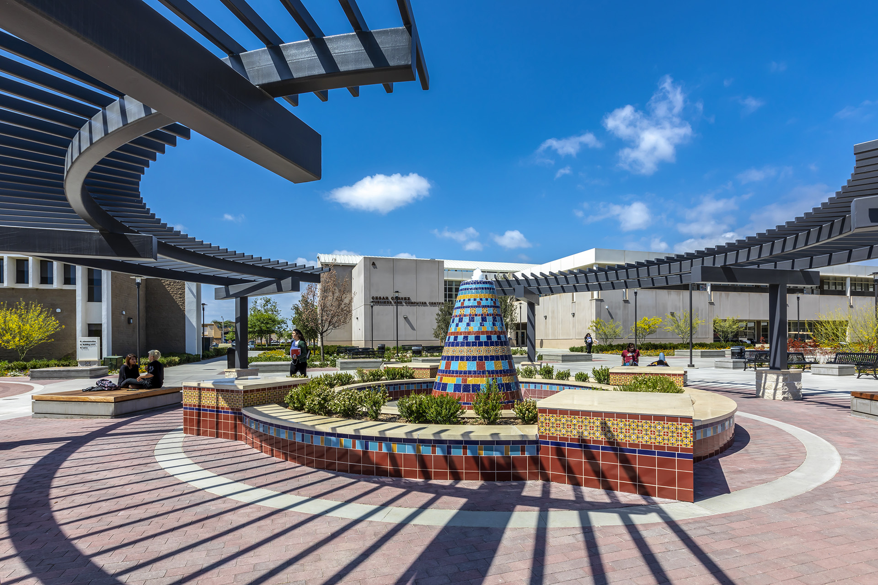
Accreditation 101 and Evidence Gathering
April 23, 2020
12:30 – 2:00pm
Monica Zarske
Accreditation Faculty Coordinator
Dr. Fernando Ortiz
Dean, Academic Affairs
Notes:
NOTE:
To change the image on this slide, select the picture and delete it. Then click the Pictures icon in the placeholder to insert your own image.

Slide 2

Accreditation 101
Overview of the Accreditation Process
Formative & Summative Processes
Standards and Structure of the Report
SAC’sTimeline
SAC’s Accreditation Organizational Structure
  Steering Committee
  Standard Teams
Resources

Slide 3
Overview of the Accreditation Process

Slide 4
Recent Changes at ACCJC
New Mission
The Accrediting Commission for Community and Junior Colleges works with its member institutions to advance educational quality and student learning and achievement.
This collaboration fosters institutional excellence and continuous improvement through innovation, self-analysis, peer review, and application of standards.
Core Values: Integrity, quality assurance, institutional improvement, peer review, student learning and achievement, and collegiality

Slide 5
Recent Changes, Continued
Improved Trainings and Resources at accjc.org
  More reliance on education
  Less reliance on sanctions to effect change
Lighten the Burden on Members
  Sub change process
  Annual report and annual fiscal report
  Midterm report
Formative/Summative Approach
Standards Review (Upcoming)

Slide 6


What is the Purpose of Accreditation?
Why Go Through This????
  Gatekeepers of federal financial aid
  Assure quality to the public and students
  Ensure institutions can meet their missions
    Student Outcomes
U.S. Higher Education – Commitment to Peer Review
  Unique to U.S.
  Uses academic inquiry to inform effective practices for improvement

Slide 7
Formative & summative review

Slide 8
Formative/Summative Approach
SAC will prepare a self-study (the Institutional Self Evaluation Report or ISER) and submits to the review team a semester prior to the site visit.
Visiting team conducts the Team ISER Review (TIR) and prepares a formative evaluation:
  Verifies compliance with many operational aspects, taking them “off the table” as not requiring onsite verification
  Specifies areas where additional information is needed, or where the institution needs to further develop its processes, in anticipation of the site visit a semester later
  Identifies focused “Core Inquiries” that will be pursued during the on-site visit
A smaller team (and/or a shorter visit schedule) conducts the Focused Site Visit, with the team report leading to summative findings.

Slide 9
Overview of the Accreditation Process
Institutional Self Evaluation Report (ISER)
  The Standards
  Eligibility and Federal Regulations
  Quality Focus Essay (QFE)
Peer Review
Site Visit

Slide 10
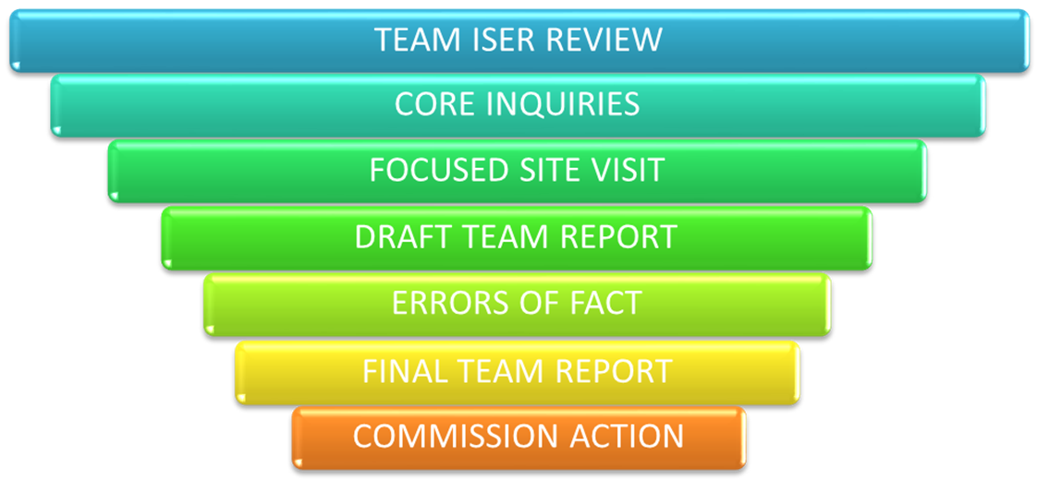
Overview of the Accreditation Process

Slide 11
Standards and structure of the report

Slide 12
ACCJC Standards
Standard I: Mission, Academic Quality and Institutional Effectiveness, and Integrity
Standard II: Student Learning Programs and Services
Standard III: Resources
Standard IV: Leadership and Governance

Slide 13
Important Tenets Embedded in the Standards
Focus on achieving institutional mission, avoiding diversion to other purposes.
Integrity and honesty in institutional policies and actions.
Focus on student outcomes – completion of meaningful education, learning, demonstrable knowledge and skills.
Metrics and evidence used to assess institutional quality.
Ongoing internal quality assurance practices.
Continuous improvement for high performance.

Slide 14
Structure of the Report
Evidence of Meeting the Standard
  This document demonstrates that the College…..
Analysis and Evaluation
  The narrative describes the evidence in more detail, analyzes HOW it demonstrates that the College meets the Standard, and evaluates the effectiveness of the policy, procedure, or practice.
Conclusion
  In two or three sentences, the conclusion should summarize the effectiveness of the College’s efforts towards the Standard. If the College determines improvements are needed, improvement plans should follow.

Slide 15
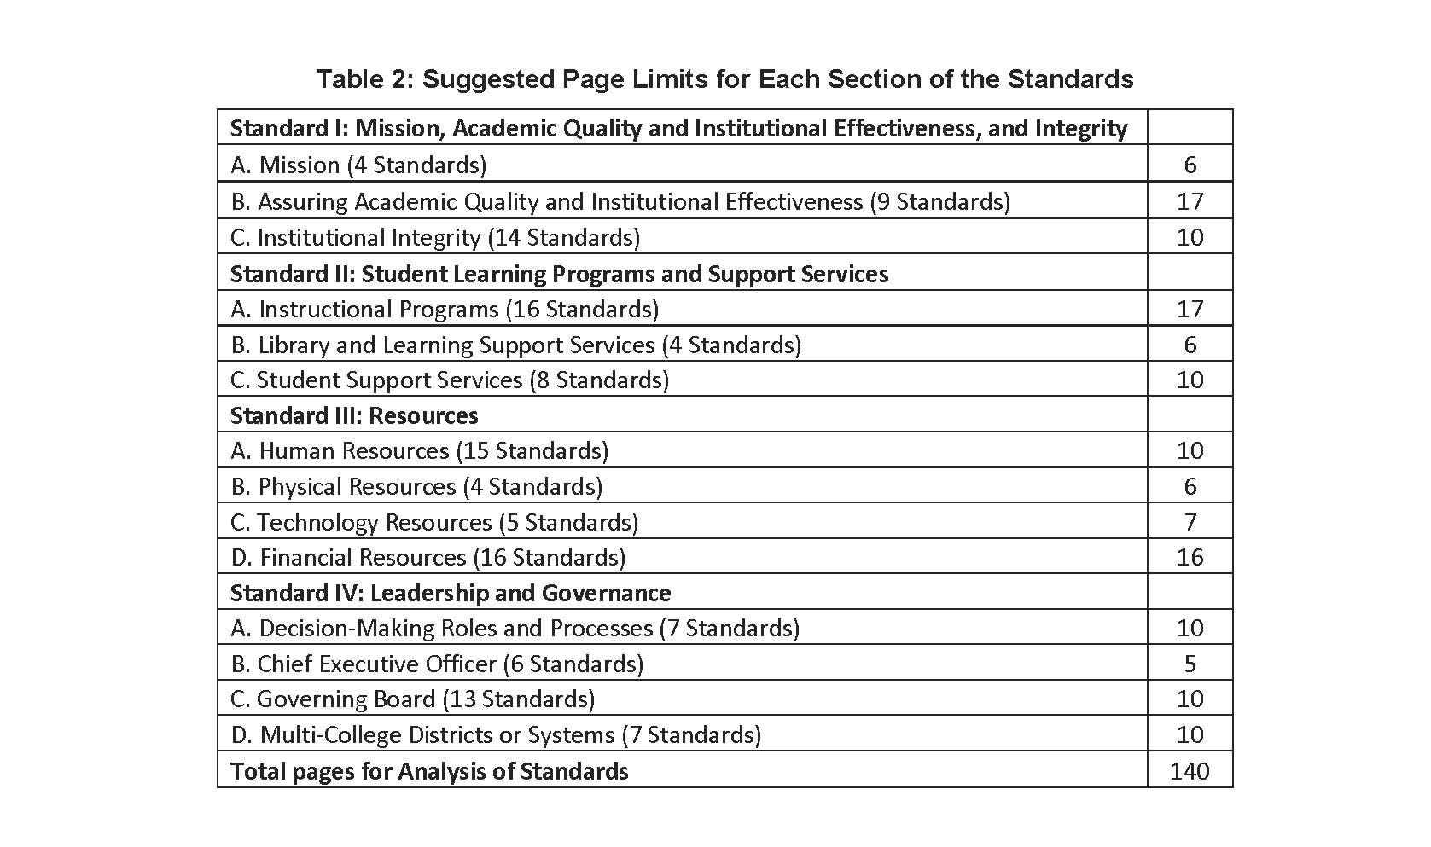

Slide 16
Santa Ana College’s timeline

Slide 17
Timeline
2019-2020 |  | 2020-2021 |  |  | 2021-2022
Fall | Spring | Summer | Fall | Spring | Summer | Fall | Spring
ACCJC Training | Continue ISER | Continue Evidence | First Draft ISER | Finalize ISER | Board Approvals | ISER Due Aug 2nd | ISER Team Visit
Form Accreditation Committee | Collect Evidence | Continue Writing | Distribute and vet ISER | Finalize QFE |  | ISER Team Review
Develop Teams | Start Writing |  |  | College Approvals |  | ACCJC Core Inquiry
Educate Campus | Identify Gaps
Begin ISER
Develop Naming Conventions
Archiving

Slide 18
Santa Ana college’s accreditation Organizational structure

Slide 19
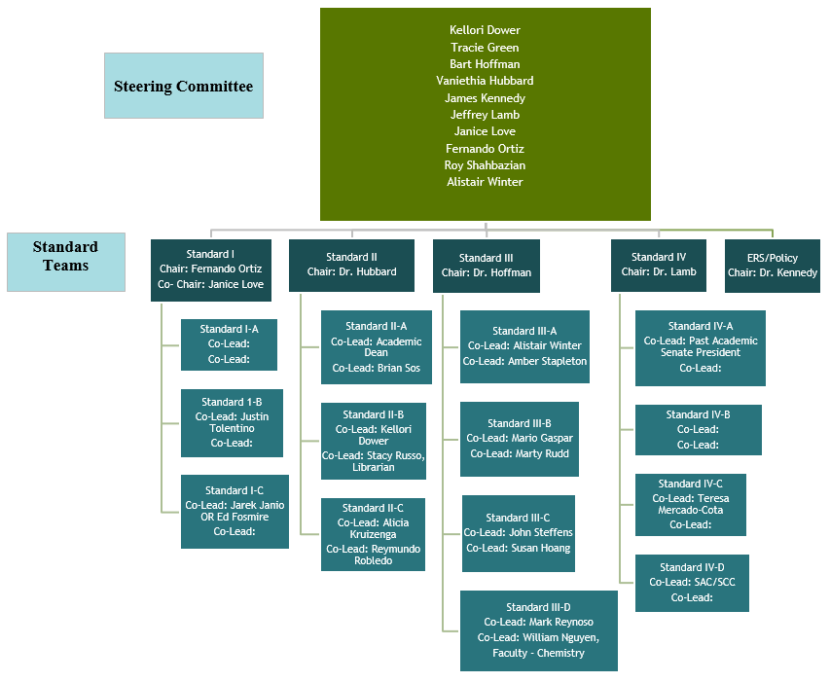
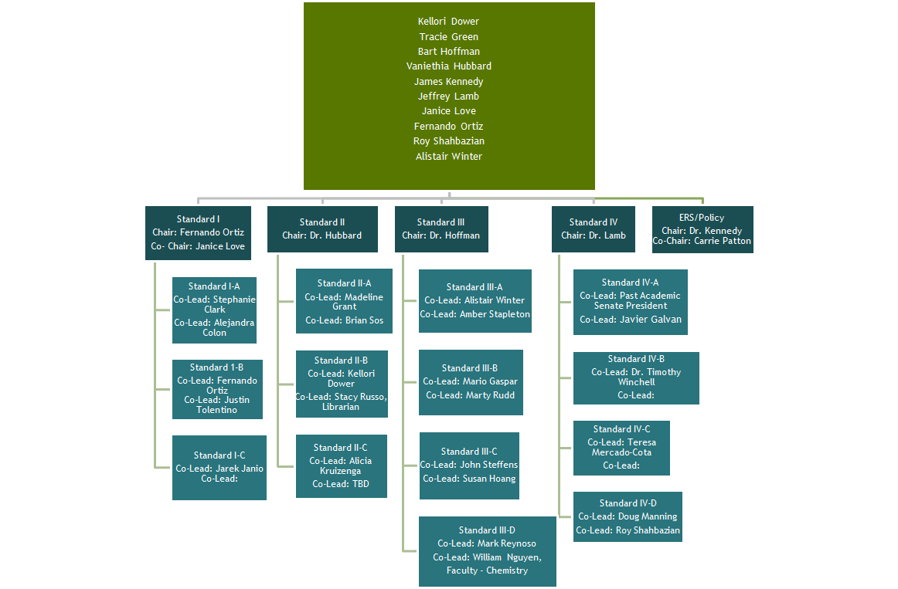
SAC’s Organizational Structure

Slide 20
Resources

Slide 21


Resources
ACCJC.org
  Accreditation Basics – online training and certification
  Guide to Institutional Self-Evaluation, Improvement, and Peer Review
Microsoft Teams

Slide 22
Questions?

